Slide 1
AR Pets
Second Update

Slide 2
What We’ve Done
Unity Work/Tutorials
Model Work
Interface Design
Planning
Funding

Slide 3
Unity Work
Free Asset Cat
Animations included
Baseline for…
Model
Animations

Slide 4
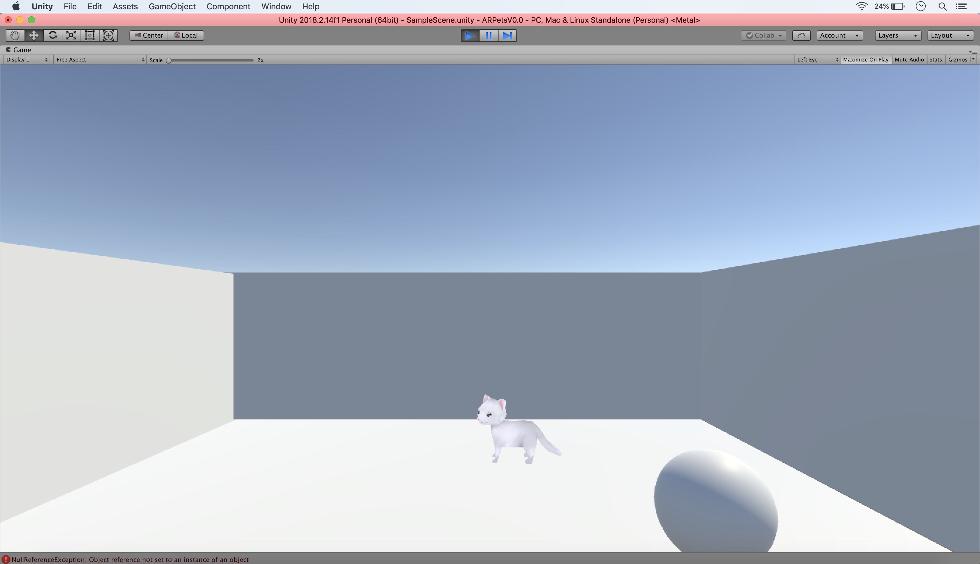

Slide 5
Unity Tutorials
Roll-a-ball (Yes, the infamous one.)

Slide 6
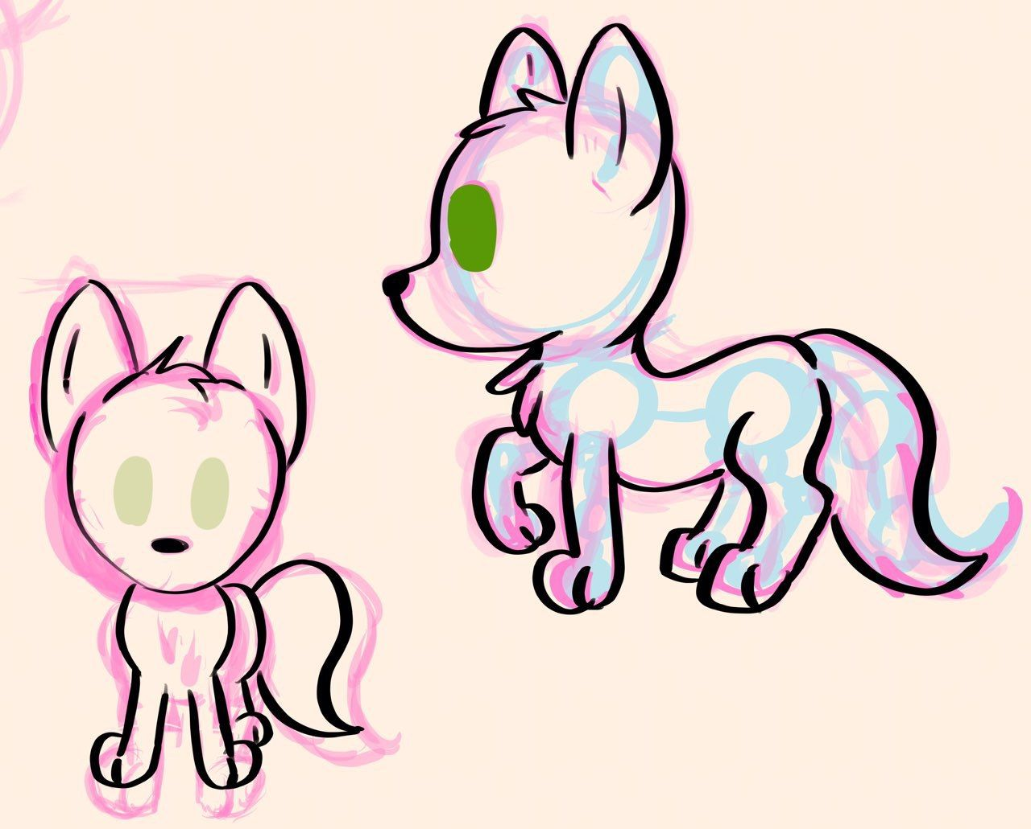
Model Work
Sketch, Modeling/Rigging in Blender

Slide 7
Interface Design
(see next slide)

Slide 8
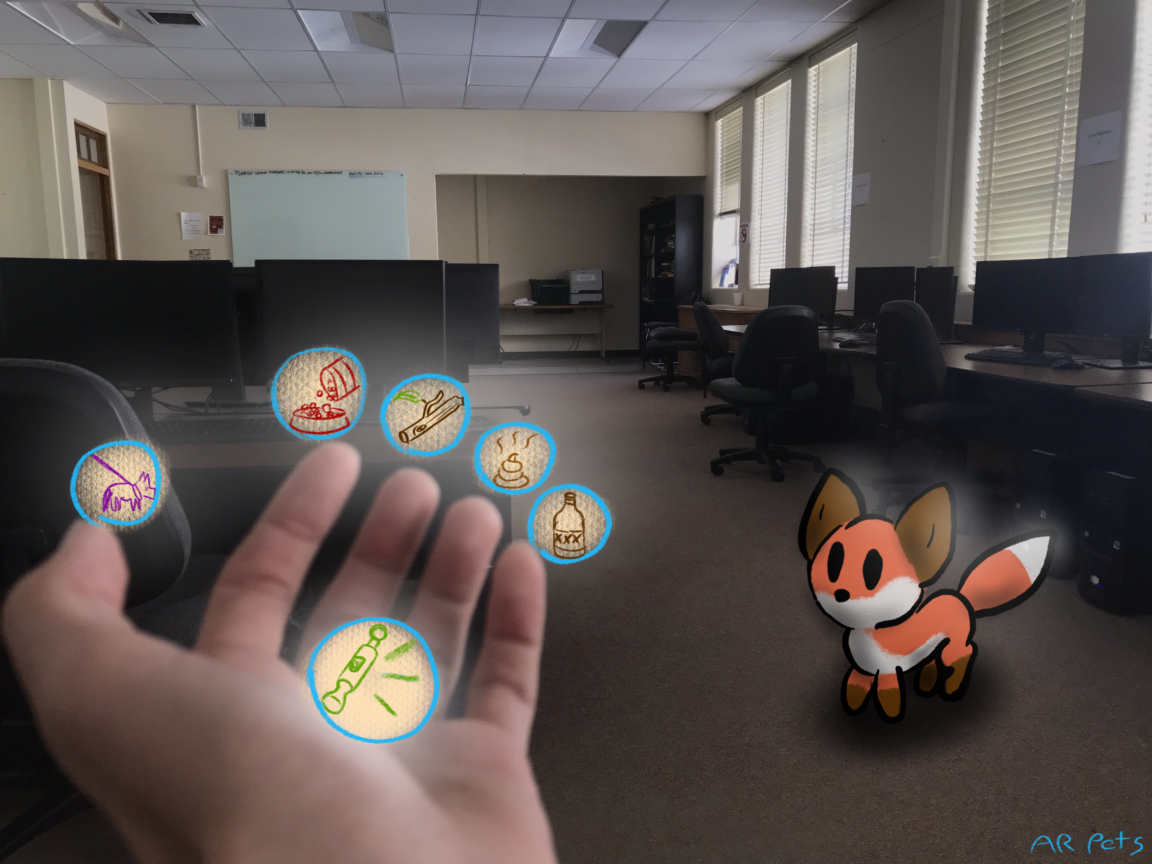

Slide 9
Roadmap for the end of break
Headset Interactivity
Furnished Environment
Develop During Winter Break
Models and Animations Done

Slide 10
Techshift
Now focusing on both AR and VR
Currently have access to the following platforms
Oculus
Vive
Hololens

Slide 11
Funding
No funding - University Resources
Magic Leap Grant

